Slide 1

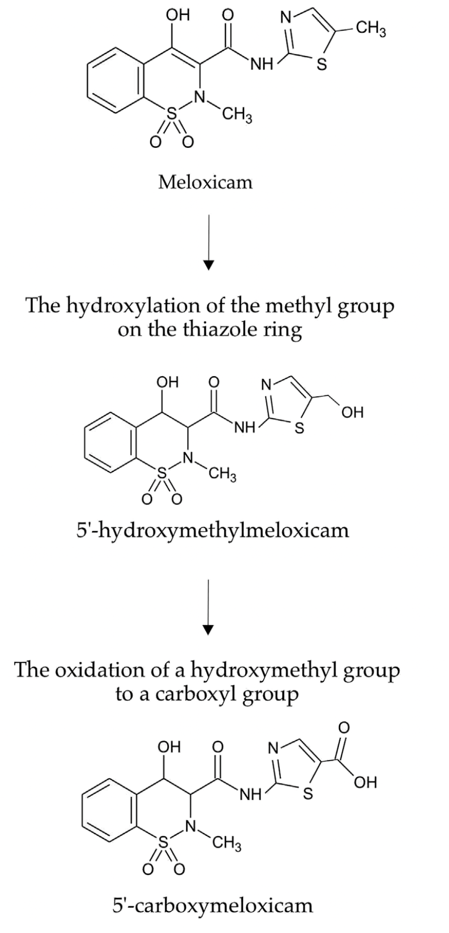
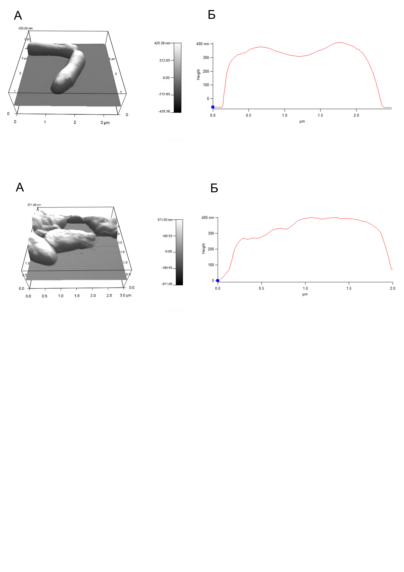
Adaptive responses of Gordonia alkanivorans IEGM 1277 to the action of meloxicam and its efficient biodegradation
Semyon Tyan, Nadezhda Kostrikina, Vladimir Sorokin, Andrey Mulyukin and Irina Ivshina
Environmental issue
Microbial biodegradation pathway
Cellular adaptive responses
Pharmaceutical pollution
Meloxicam (NSAID)
Persistent, toxic, poorly removed
by conventional wastewater treatment
Aquatic and terrestrial ecosystems at risk
Organism:
Gordonia alkanivorans IEGM 1277
Adaptive defence mechanisms
Increased respiratory activity
Altered cell surface charge (ζ-potential shift to −21 mV)
Accumulation of intracellular lipid droplets
Copper enrichment supporting oxidative enzymes
Preserved cell integrity under toxic stress
Key processes:
High tolerance to meloxicam (MIC ≥ 5 g/L)
Cytochrome P450–dependent monooxygenation
Sequential oxidation reactions
Environmental outcome
Reduced toxicity & biotechnological relevance
Complete meloxicam removal
(10 mg/L in 14 days)
Metabolites exhibit 1.5–10×
lower predicted ecotoxicity
No detectable antimicrobial
or pharmacological activity
Application:
Sustainable bioremediation
of pharmaceutical wastewater
Environmentally safe detoxification strategy

